Slide 1

Notes:
Welcome to the Product Demo of NapEze, a solution to help new time parents improve their wellbeing by improving their child’s sleep

Slide 2
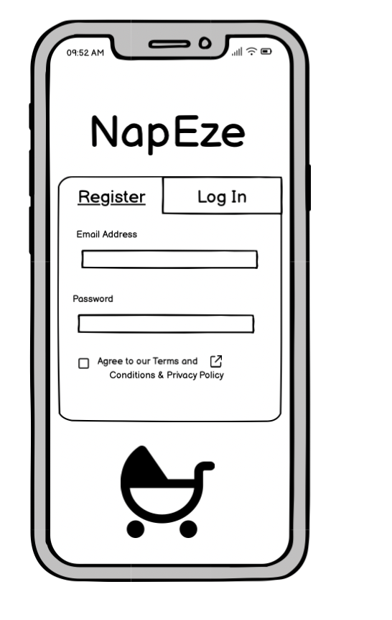
Notes:
This is the first screen the user will see as they open the app for the first time
User will need to enter their email and a password
Must agree to the Terms and conditions and the privacy agreement before entering
who developed the technology and is liable in cases of wrongdoing
collection, processing, and secure storage of their data
rights under data protection law

Slide 3
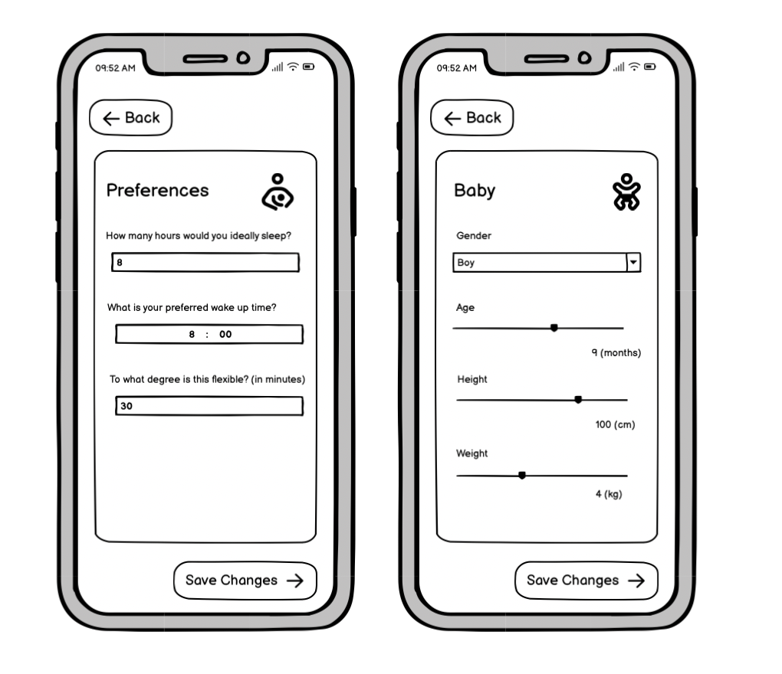
Notes:
Here the Stuart will be able to choose their
Discuss his choices
no identifying data is recorded (no names addresses or unnecessary appearance information)

Slide 4
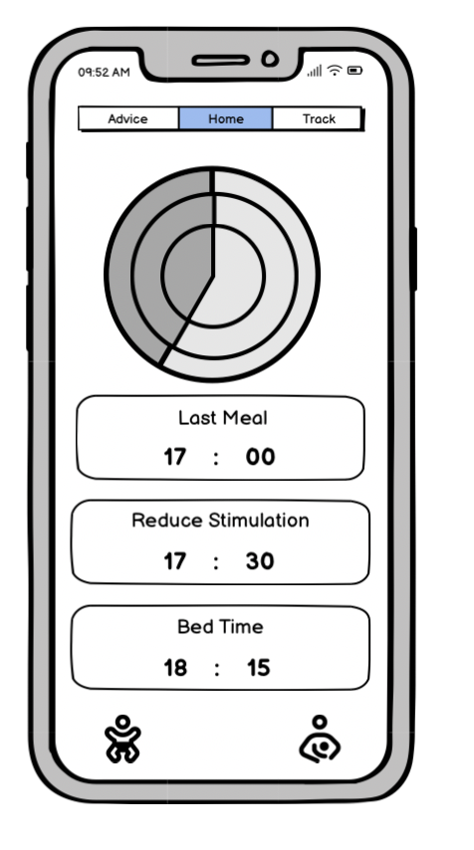
Notes:
Shows the first recommendation from the system
A clock infographic
Individual numbered times for each section

Slide 5
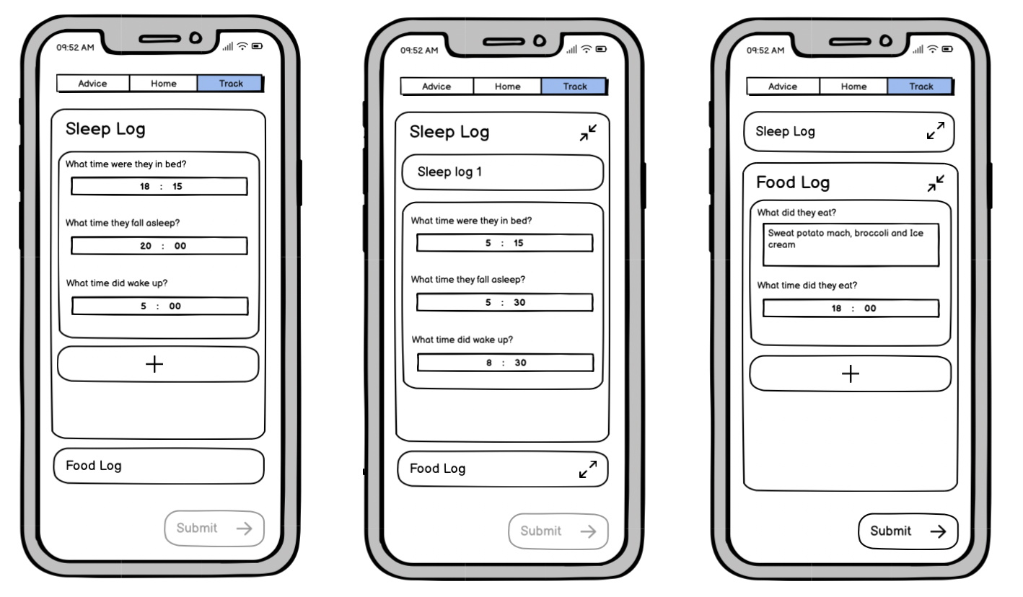
Notes:
Clicked on track
Discuss the log
Only allowed to submit one the user log is complete

Slide 6
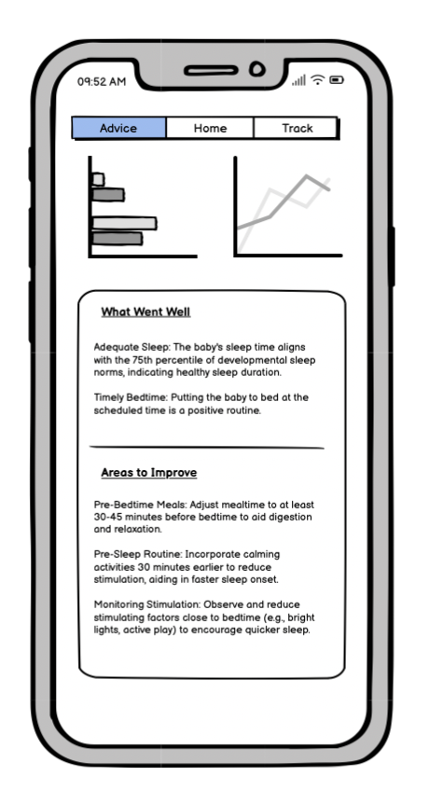
Notes:
Taken straight to the advice page
.
System will look at Stuarts log and compare it to it’s own recommended schedule
This is provides advice based on the sleep and meal logs
Recognise what went well:
In this case:
Identify areas to improve:
To bring stuart closer to the baby's optimal schedule

Slide 7
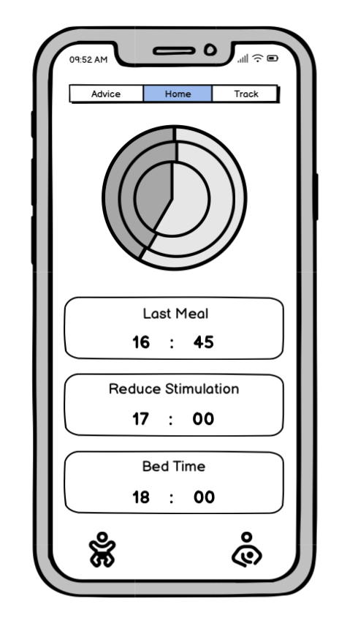
Notes:
When stuart then chooses the home page he will see the new optimized schedule
In the timestamps and clock inforgraphic
that has been adjusted based on yesterdays sleep log
From here stuart will also be able to update his baby's profile and his preferences respectivly so should eithe rof these change

